Slide 1
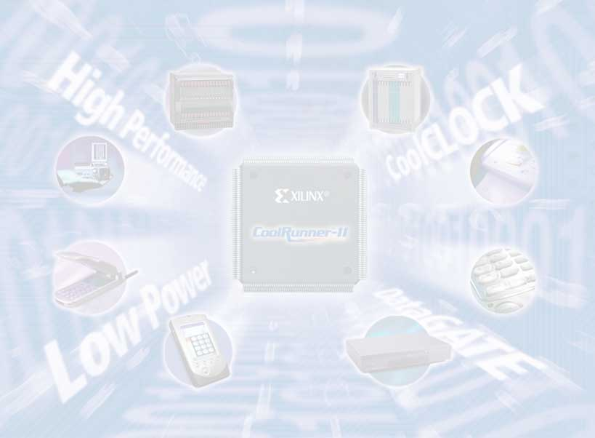
ECE 448 FPGA Design with VHDL
Spring 2024

Slide 2
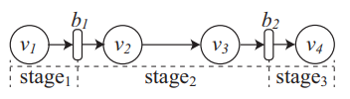
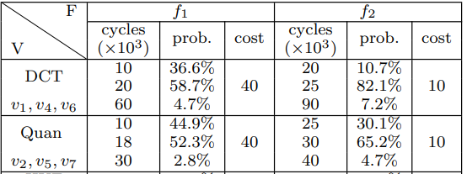
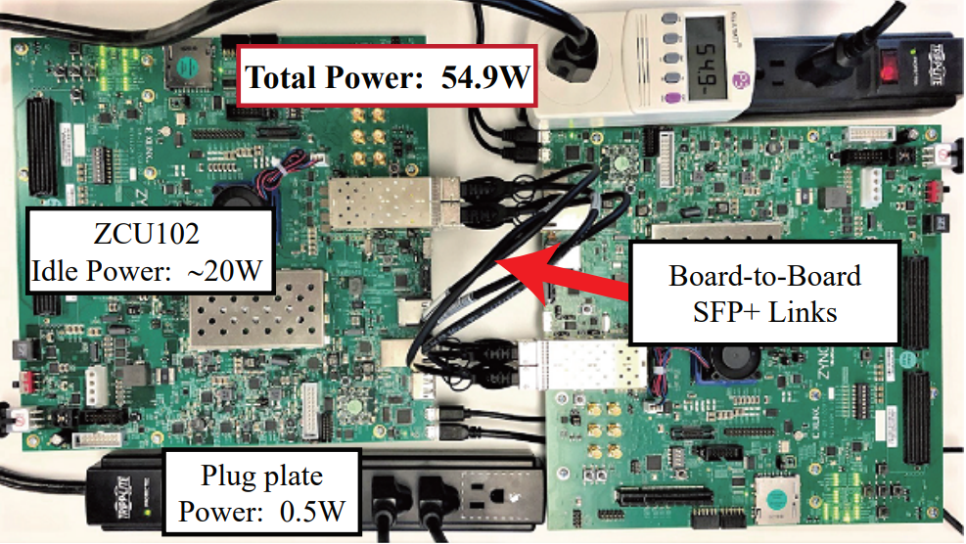

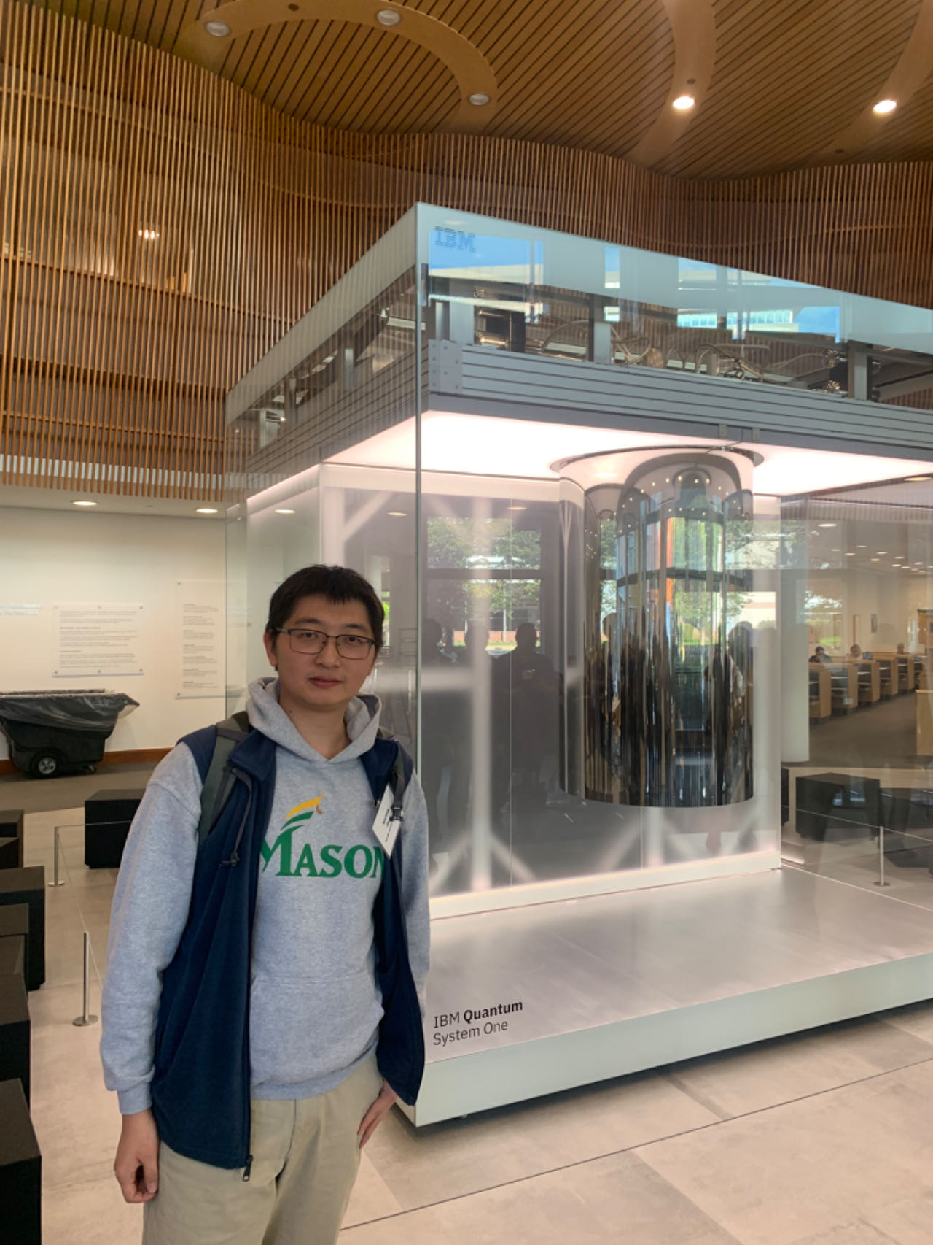
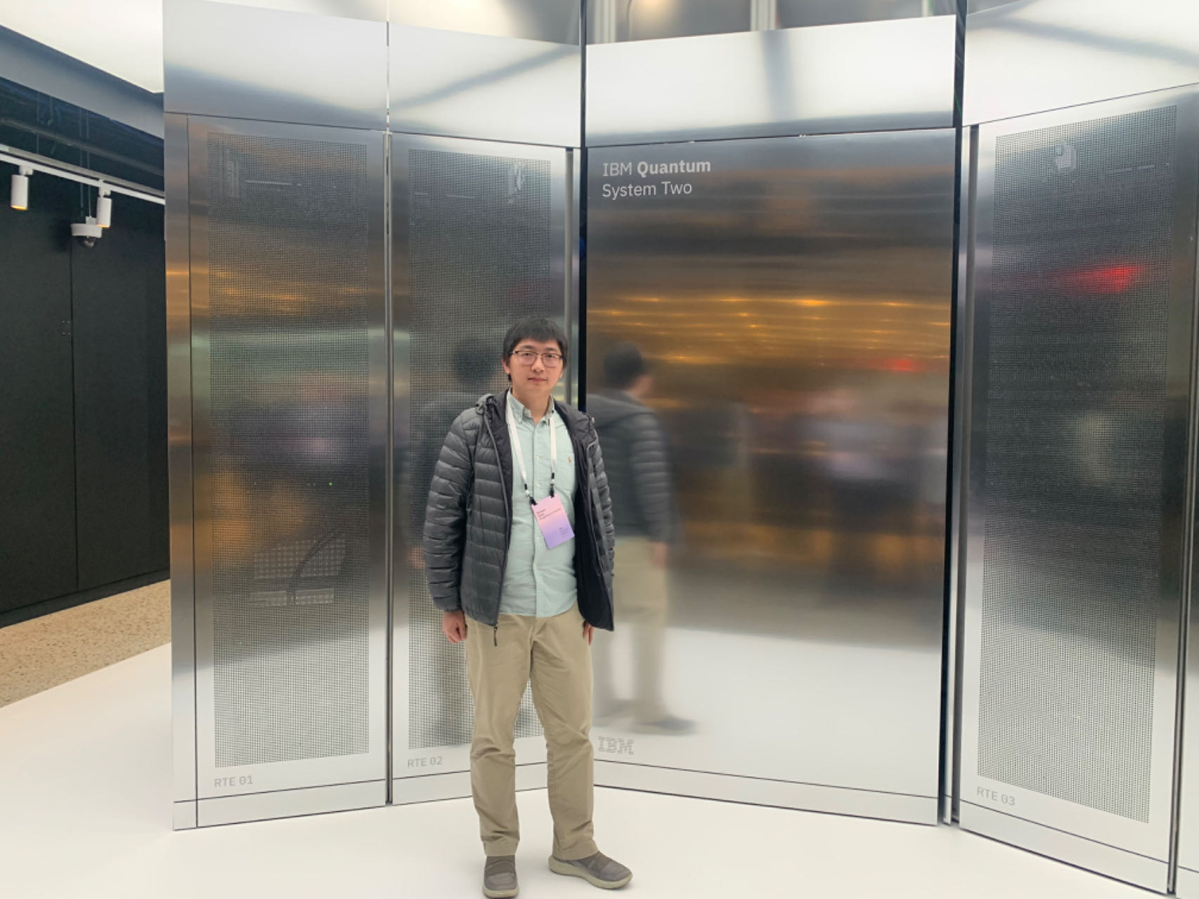
Weiwen [way-when] Jiang [jee-aang] /dʒiˈæŋ/
Research and teaching interests:
SW/HW co-design
FPGA design
High-level synthesis
Edge Machine Learning
Quantum computing
Contact:
wjiang8@gmu.edu
Subject: ECE448 …
2013 - 2017
2017 - 2021
2021 - now

Slide 3
Course Web Page
https://jqub.ece.gmu.edu/2024/01/01/24SECE448/
ECE 448 FPGA Design with VHDL

Slide 4

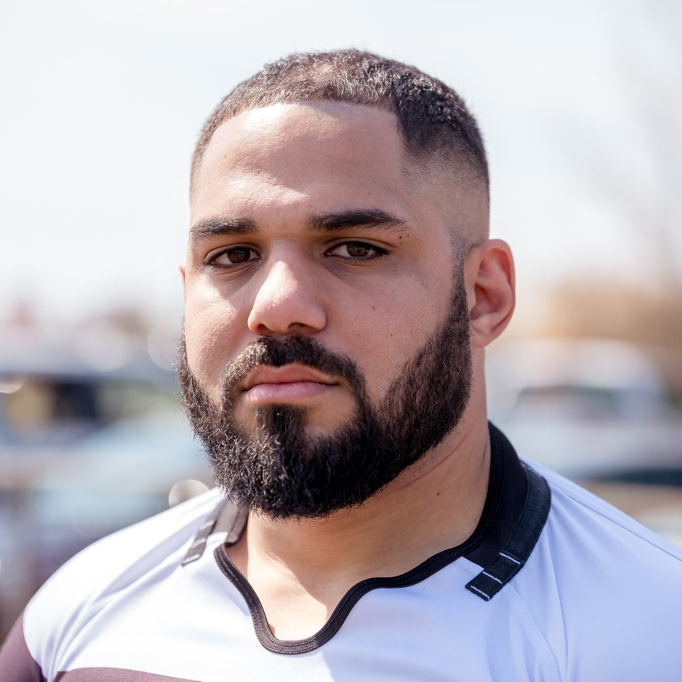

TA Team
Miguel Medina
Corey Kaiser
Kabir Basnet
Photo
Lab TA
mmedin23@gmu.edu
Telecommunications and Computer Engineering graduate student
Lab TA
ckaiser2@gmu.edu
Computer Engineering Graduate Student
Course TA
kbasnet4@gmu.edu
Bachelors in Computer Engineering
Software Engineer

Slide 5
Course Hours
Lecture:
Monday, Wednesday
12:00-13:15 PM
Exploratory Hall L003
Lab Sessions:
Wednesday Friday Monday 7:20-10:00 PM 8:40-11:20 AM 9:00-11:40AM
Jan. 24 Jan. 26 Jan. 29
TA: Miguel TA: Corey TA: Corey
Location: ENGR 3208

Slide 6
General Section Assignment Rules
You should do your best to attend all lab meetings
of the section you are registered for
If you have missed a meeting of your section,
please attend a meeting of another section
6

Slide 7
In Person Office Hours
Instructor: Dr. Weiwen Jiang
Monday, Wednesday, 2:00-3:00 PM
ENGR 3247
TA: Corey Kaiser
Monday 3:00-5:00 PM,
Thursday 2:00-4:00 PM
ENGR 3208
TA: Miguel
TBD

Slide 8

Getting Help Outside of Office Hours
System for asking questions 24/7
Answers can be given by students and instructors
Student answers endorsed (or corrected) by instructors
You can submit your questions anonymously
You can ask private questions visible only to
the instructors
[Signup] https://piazza.com/gmu/spring2024/ece448
[Code] vba328kibjl
Contact: Kabir Basnet (kbasnet4@gmu.edu)

Slide 9
Undergraduate Computer Engineering Courses
ECE 231
ECE 232
Digital System Design
ECE 445
Computer Organization
ECE 448
ECE 447
FPGA Design with VHDL
Microcontrollers
Color code:
ECE 492
BS EE
Senior Advanced Design Project
ECE 493
BS CpE
9

Slide 10
10

Slide 11
11

Slide 12
Digital system design technologies
coverage in the CpE & EE programs at GMU
Microprocessors
FPGAs
ASICs
ECE 448 FPGA Design with VHDL
ECE 350
Embedded Systems and Hardware Interfaces
ECE 431
ECE 445
Computer Organization
Digital Circuit Design
ECE 447
Microcontrollers
ECE 511
Computer
Architecture
ECE 545
Digital System
Design with
VHDL
ECE 586
Digital
Integrated
Circuits
ECE 611
Advanced
Computer
Architecture
ECE 554
Machine Learning for Embedded Systems
ECE 681
VLSI Design
for ASICs
ECE 612
Real-Time Embedded
Systems
ECE 505
Hardware Security
ECE 615
Software/Hardware Codesign
ECE 618
Hardware Accelerators for
Machine Learning
12

Slide 13
Course Web Page
https://jqub.ece.gmu.edu/2024/01/01/24SECE448/
Organization
Instructor
Teaching Assistant
Office Hours
Grading
Lecture
Textbooks
Lecture Slides
Homework
Midterm Exams
Final Exams
Lab
Rules
Lab Assignments
Lab Slides & Examples
Software
Hardware
Useful References
Lab Exams
13

Slide 14
Grading criteria
First part of the semester:
Lab experiments - Part I
25%
Lab exercises – Part I
2%
Quizzes & homework: 3%
Midterm exam for the lecture: 10%
Midterm exam for the lab: 15%
Second part of the semester:
Lab experiments - Part II
15%
Lab exercises – Part II
2%
Quizzes & homework: 3%
Final exam
25%
14

Slide 15
Tentative Grading Scheme for the Labs
Lab 1: Developing VHDL Testbenches – 5 points
Lab 2: Combinational Logic – 5 points
Lab 3: Sequential Logic – 5 points
Lab 4: State Machines. Basic I/O Devices. – 10 points
Lab 5: MicroBlaze – Basic I/O Devices
Lab 6: MicroBlaze – Computer Graphics
Total: 25 points
Total: 15 points
15

Slide 16
Penalties and Bonus Points
Penalties:
one-week delay: 1/4 of points
i.e., you can earn max. 7.5 out of 10 points
No submissions or demos will be accepted more than one week
after the assignment is due!
16

Slide 17
Flexibility in the Second Part of the Semester
Schedule A+:
Intended for students who do very well in the first part of the semester (preferably ≥ 90% of points for Labs 1-4)
An open-ended project proposed by students, having a discussion with the TAs and/or the instructor
Can be done individually or in groups of two students
Schedule: Detailed Specification (1 week)
Milestone 1 (2 weeks)
Milestone 2 (2 weeks)
Final Report & Deliverable (1 week)
Total: 20 points
17

Slide 18
Exams
Midterm Exam for the Lecture – 10 points Wednesday, Feb. 28, 12:00-13:15
Midterm Exam for the Lab (hands-on) – 15 points
March 13, 15, 18 --- According to which lab you selected
Final Exam – 25 points Monday, May 06, 10:30 AM-1:15 PM
18

Slide 19
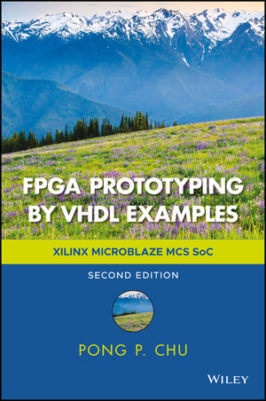
Required Textbook
Pong P. Chu, FPGA Prototyping by VHDL Examples: Xilinx MicroBlaze MCS SoC, Wiley, Oct. 2017.
19

Slide 20

Supplementary Textbook – Basics Refresher
Stephen Brown and Zvonko Vranesic,
Fundamentals of Digital Logic with VHDL Design, McGraw-Hill, 3rd Edition, 2008.
20

Slide 21

Supplementary Textbook – Advanced
Ricardo Jasinski, Effective Coding with VHDL: Principles and Best Practice, The MIT Press; 1st Edition, 2016.
21

Slide 22
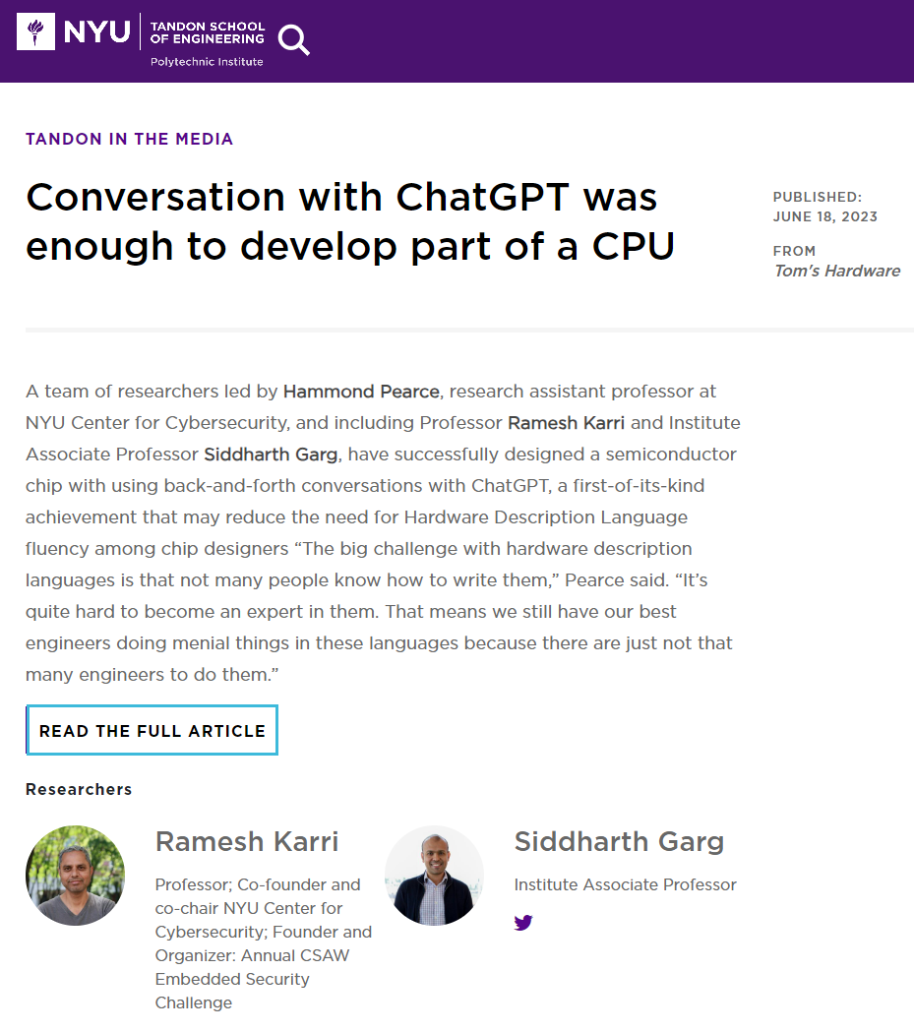
Supplementary: ChatGPT as an Assistant but not a Writer
22

Slide 23

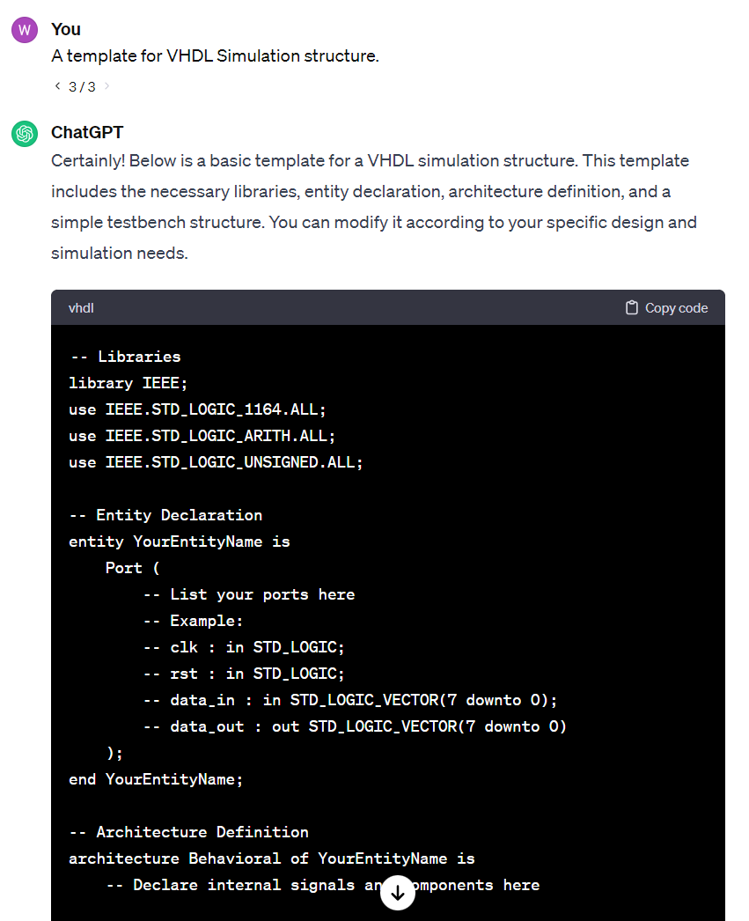
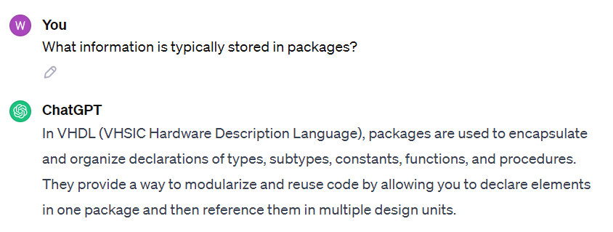
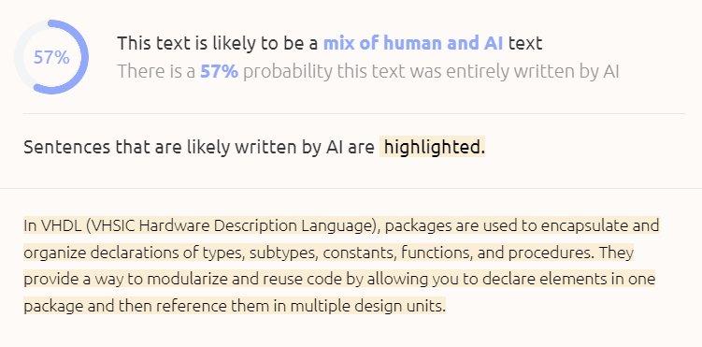
Supplementary: ChatGPT as an Assistant but not a Writer
Do not use it for writing lab, quiz, or homework
Okay to use it for assistance
Generated stuff can be easily detected!
23

Slide 24
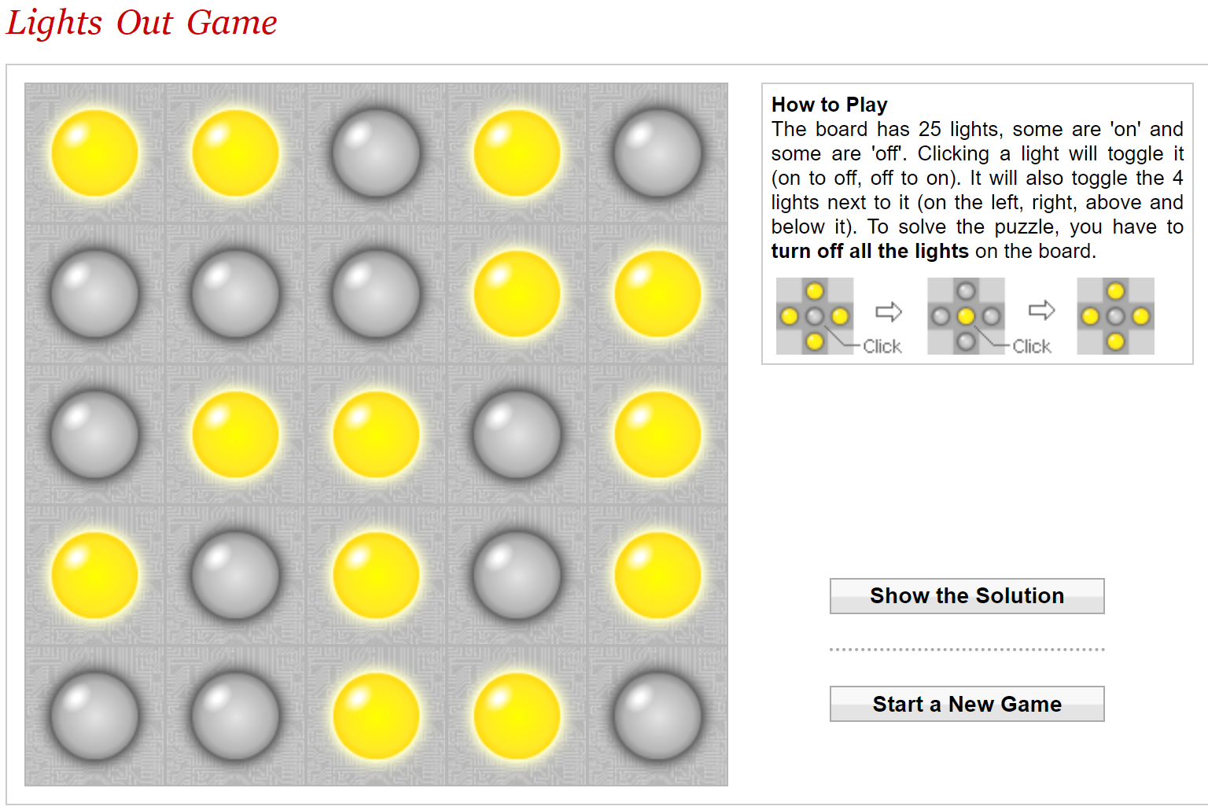
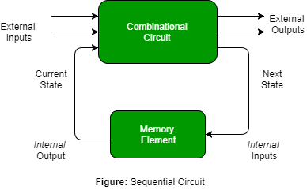

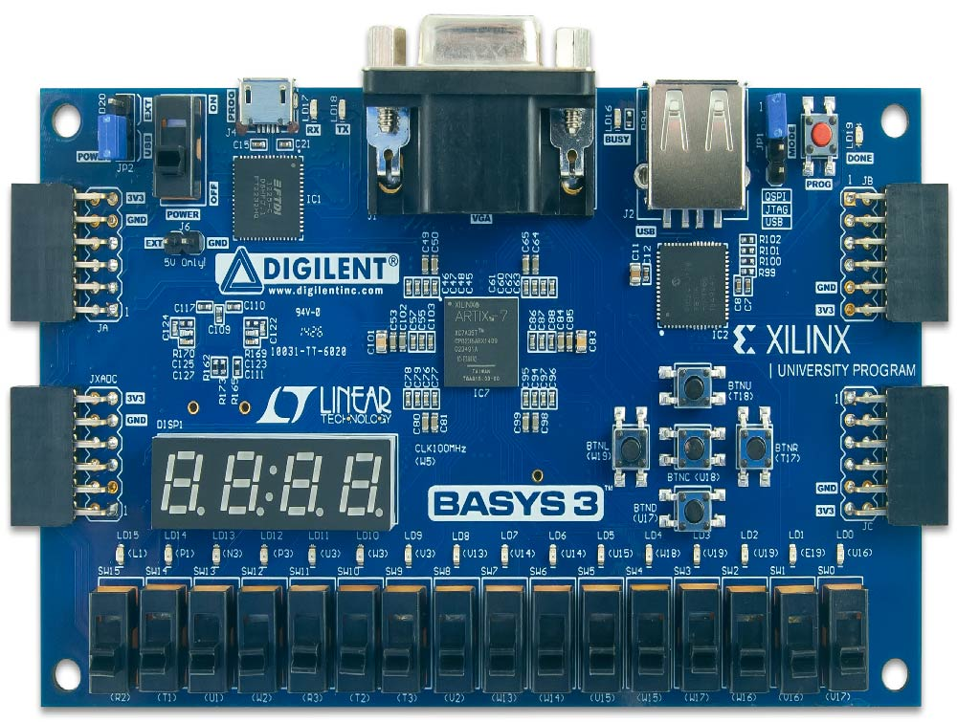
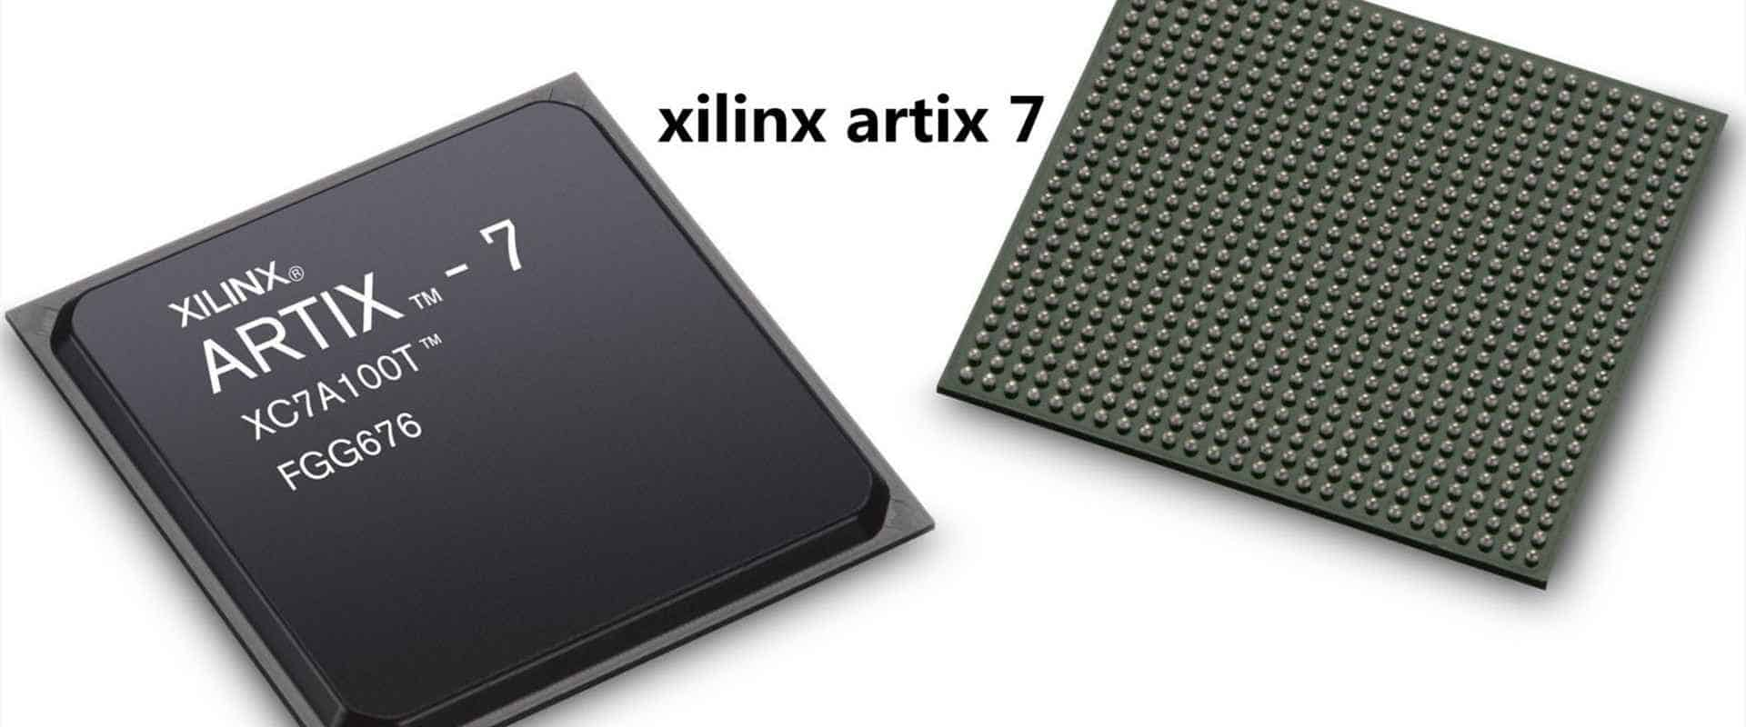
ECE 448: FPGA Design with VHDL
Overview and Goal
Fundamentals:
Advanced digital system design with VHDL
Application (1): LightsOut Puzzle on FPGA
Sequential circuit
Embedded Resources
Memory, DSP, etc.
Testbench
Process, variable, etc.
State machine
Processor
Application (2): Sorting on FPGA
Register
Soft-core: MicroBlaze
Hard-core: ZYNQ
I/O
Button, LED
Seven Segment Display

Slide 25
Why ECE 448 is a challenging course?
need to refresh and strengthen your VHDL skills
need to learn new tools
need to perform practical experiments
time needed to complete experiments
25

Slide 26
Difficulties
(based on previous student survey)
finding time to do the labs – 15
learning VHDL – 2
getting used to software – 1
26

Slide 27
Why is this course worth taking?
VHDL for synthesis:
one of the most sought-after skills
knowledge of state-of-the-art tools used in the industry
knowledge of the modern FPGA technology
knowledge of state-of-the-art testing equipment
design portfolio that can be used during job interviews
unique knowledge and practical skills that make you
competitive on the job market
27

Slide 28
ECE 448: FPGA Design with VHDL
Topics
VHDL:
- writing testbenches
- writing synthesizable code in VHDL
FPGAs:
- architecture of FPGA devices
- embedded resources (memories, DSP units)
- tools for the computer-aided design with FPGAs
- FPGA families
28

Slide 29
Applications:
- LightsOut puzzle
- basics of computer arithmetic
Platforms & Interfaces:
FPGA boards
I/O modules (seven segment display, etc.)
Design Techniques:
microprocessors embedded in FPGAs (MicroBlaze)
software/hardware co-design
29

Slide 30
Tasks of the course
Advanced
course on digital
system design
with VHDL
Comprehensive
introduction to
FPGAs
Testing
equipment
writing VHDL code
for synthesis
design using
division into the
datapath & controller
- testbenches
SW/HW codesign
- I/O register map
- timing analysis
hardware:
Xilinx FPGAs
MicroBlaze
- software:
Simulators
Synthesis tools
Implementation tools
- oscilloscopes
- logic analyzers
30

Slide 31
VHDL for Specification
VHDL for Simulation
VHDL for Synthesis
31

Slide 32
Levels of design description
Levels supported by HDL
Algorithmic level
Level of description
most suitable for synthesis
Register Transfer Level
Logic (gate) level
Circuit (transistor) level
Physical (layout) level
32

Slide 33
Register Transfer Level (RTL) Design Description
Combinational
Logic
Combinational
Logic
…
Registers
Use of medium scale-components (adders, multipliers, MUXes, ROMs, RAMs, registers, counters, etc.)
The designer needs to specify what happens in the circuit in every clock cycle
33

Slide 34
What is an FPGA?
Configurable
Logic
Blocks
Block RAMs
Block RAMs
I/O
Blocks
Block
RAMs
34

Slide 35
Modern FPGA
RAM blocks
DSP units
Logic resources
(CLBs or ALMs)
(#Logic resources, #DSP units, #RAM_blocks)
Graphics based on The Design Warrior’s Guide to FPGAs Devices, Tools, and Flows. ISBN 0750676043 Copyright © 2004 Mentor Graphics Corp. (www.mentor.com)

Slide 36
General structure of an FPGA
The Design Warrior’s Guide to FPGAs Devices, Tools, and Flows. ISBN 0750676043 Copyright © 2004 Mentor Graphics Corp. (www.mentor.com)

Slide 37
Two competing implementation
approaches
ASIC
Application Specific
Integrated Circuit
FPGA
Field Programmable
Gate Array
designed all the way
from behavioral description
to physical layout
no physical layout design;
design ends with
a bitstream used
to configure a device
designs must be sent
for expensive and time
consuming fabrication
in semiconductor foundry
bought off the shelf
and reconfigured by
designers themselves
37

Slide 38
FPGAs vs. ASICs
ASICs
FPGAs
Off-the-shelf
High performance
Low development costs
Low power
Short time to the market
Low cost (but only
in high volumes)
Reconfigurability
38

Slide 39
FPGA Design process (1)
Design and implement a simple unit permitting to speed up encryption with RC5-similar cipher with fixed key set on 8031 microcontroller. Unlike in the experiment 5, this time your unit has to be able to perform an encryption algorithm by itself, executing 32 rounds…..
Specification (Lab Assignments)
On-paper hardware design
(Block diagram & Algorithmic State Machine chart)
VHDL description (Your Source Files)
Library IEEE;
use ieee.std_logic_1164.all;
use ieee.std_logic_unsigned.all;
entity RC5_core is
port(
clock, reset, encr_decr: in std_logic;
data_input: in std_logic_vector(31 downto 0);
data_output: out std_logic_vector(31 downto 0);
out_full: in std_logic;
key_input: in std_logic_vector(31 downto 0);
key_read: out std_logic;
);
end AES_core;
Functional simulation
Synthesis
Post-synthesis simulation
39

Slide 40
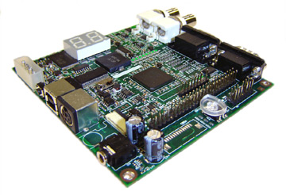
FPGA Design process (2)
Implementation
Timing simulation
Configuration
On chip testing
40

Slide 41
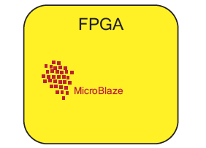
Software/Hardware Codesign
FPGA with a Soft-Core Processor
Source: The Zynq Book
41

Slide 42
FPGA Boards
42

Slide 43
43

Slide 44
Software vs. Hardware Trade-offs
Source: A Practical Introduction to Hardware/Software Codesign
44

Slide 45
wjiang8@gmu.edu
George Mason University
4400 University Drive Fairfax, Virginia 22030
Tel: (703)993-1000

